Slide 1
Fall 2016 Quarterly Update
Medical Staff Affairs

Slide 2
Agenda
Quick Updates
Credentialing and Privileging
Provider Health Plan Enrollment
Prescription Pad Security and Management
“Busy Season” 2016 Overview
Provider Onboarding Taskforce Update
Medical Staff Investigations

Slide 3
Updates – Credentialing and Privileging
Continued Commitment to Improving Our Process
Many will be receiving a satisfaction survey for our department. We’d really appreciate if you could give us feedback to let us know how we can improve.
Continuing to ramp up FPPE efforts so be on the lookout for those.
Poor compliance with obtaining documentation of proctoring. If it’s not documented, it never happened…
Developing many standardized guidelines on our end to ensure greater consistency across our department.

Slide 4
Updates – Credentialing and Privileging
Reminder – CVO’s commitment to 25 day turnaround time is business days from time of receipt for completed application submitted.
Urgent applications submitted to meet patient care needs, please include the following in chair recommendation letter:
Nature of urgent need
Location of practice
Proposed effective date
Malpractice coverage

Slide 5
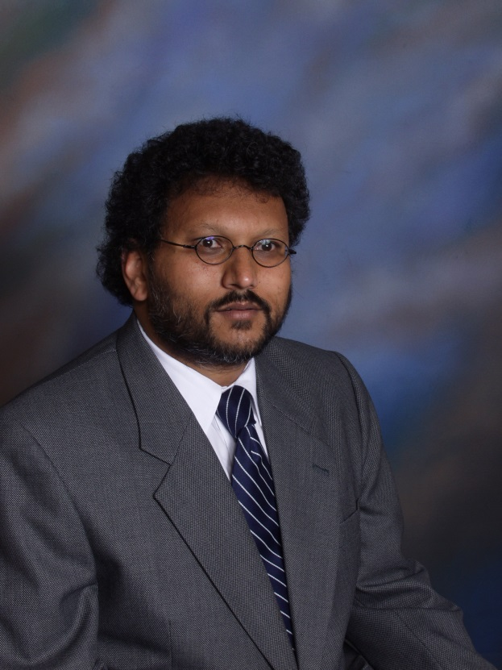
Updates – Credentialing and Privileging
Reminder – Current Credentials Committee Chair is President-Elect, Dr. Errol Lobo.
Errol Lobo, MD, PhD
Chairman, Credentials Committee
Professor and Vice Chair, Department of Anesthesia and Perioperative Care
Medical Director, Perioperative Services

Slide 6
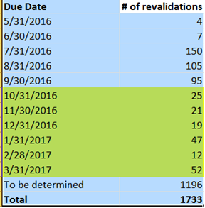
Updates – Provider Health Plan Enrollment
Medicare Revalidations
The Affordable Care Act requires all Medicare providers and suppliers to revalidate their status and enrollment information.

Slide 7
Updates – Provider Health Plan Enrollment
California Children Services (CCS)
A state program administered by Department of Health Care Services (DHCS) and coordinated with Medi-Cal enrollment
A government/public insurance “product” that reimburses at a fortified rate (from Medi-Cal) for certain pediatric conditions/diseases.
CCS Paneling is a separate process from Medi-Cal enrollment, but relies on an active Medi-Cal status.
Both CCS and Medi-Cal are administered by DHCS, but the two programs don’t necessarily share information with one another.
There are two devoted analysts who manage the CCS-paneling process.
Tremendous impact on UCSF’s operations and finances.

Slide 8
Medi-Cal DHCS
Medi-Cal Requirements
6216 Application
w/ Original Signature
Copy of Diploma
(For non MDs or
PHDs only )
Common Requirements
Copy of NPI Registry
Copy of Board Certificate
Copy of Professional License
Copy of Professional Liability Insurance
CCS Requirements
Electronic Application
Submission
- Copy of CV
Recommendation
Letter from the
Medical Director of
the Facility
If not board certified, letter documenting plan to take board examination
California Children Services (CCS) Paneling
MSO Prepares Application
MSO Prepares and Submits Application
MSO Submits Application
CCS receives application and begins processing
The Life
Of An
Application
DHCS receives application and begins processing
If Provider is NOT active w/ Medi-Cal
If Provider is NOT Board Certified
Return For More Information (RFI)
Return For More Information (RFI)
Rejected
Provisional Approval
Approved
Approved

Slide 9
Updates – Provider Health Plan Enrollment
CCS Paneling - Takeaways
Processing Time: 2-4 Months.
As of today, CCS is currently working on August 2016 applications; backlogged.
CCS will automatically panel a provider who is active with Medi-Cal and Board Certified.
If the Provider is NOT Board Certified, CCS may grant 2 year Provisional Approval.
After 2 years, CCS will automatically deactivate provisional approvals unless Board Certification is updated.
CCS will automatically reject an application if the provider is not enrolled with Medi-Cal.
CCS will panel upon Medi-Cal approval.
Requires follow up with CCS.

Slide 10
Updates – Prescription Pads
University-wide effort to improve the security and monitoring of university-issued prescription pads.
Medical Center Policy: 06.09.27 “Medication Management: Prescription Security was updated to meet recommendations from a Medical Staff Ad Hoc Investigation.
Bold attempt to eliminate the use of prescription pads and to ramp up the prescription printers stationed throughout the clinical enterprise.
Prescription pads and all sheets must be accounted for through monitoring logs.
Destruction of a prescription pad must be witnessed by two colleagues along with an attestation of the pad/form numbers.
Loss/theft/diversion of pads/forms must be reported to the Drug Enforcement Administration and the Department of Justice.

Slide 11
Busy Season 2016 – Volume
Total # of Files
528
732
751

Slide 12
Busy Season 2016 – Performance
Business Days
Notes:
Average Business Days
Initial
Reappointment
June 2015
53.82
36.59
July 2015
57.38
32.33
August 2015
46.02
35.89
June 2016
23.92
12.86
July 2016
21.61
10.92
August 2016
20.18
9.83

Slide 13
Busy Season 2016 – Financial Performance
Credentialing Bad Debt (gross charges)
 | YTD | Prior YTD | YTD Change | YTD Growth
McKesson | $ 22,308 | $ 596,728 | $ (574,420) | -96.3%
MGBS | $ 285,504 | $ 2,804,220 | $ (2,518,716) | -89.8%
Total | $ 307,813 | $ 3,400,948 | $ (3,093,135) | -90.10%
Notes:
Average Business Days
Initial
Reappointment
June 2015
53.82
36.59
July 2015
57.38
32.33
August 2015
46.02
35.89
June 2016
23.92
12.86
July 2016
21.61
10.92
August 2016
20.18
9.83

Slide 14
Busy Season 2016 – Quality Reviews
National Committee for Quality Assurance (NCQA) | Center for Medicare & Medicaid Services (CMS)
Administered by Industry Collaboration Effort (ICE) | Administered by The Joint Commission (TJC) & California Department of Health (CDPH)
Performance
Commercial Contracts – 99% | Zero Medical Staff findings during full accreditation TJC survey
Managed Medi-Cal Contracts – 100% | TJC Intra-cycle Lab Survey Finding: Provider Performed Microscopy (PPM) competencies and privileges
Findings: DEA Certificates and Attestation Statements | Improvement Focus: Proctoring/FPPE for all new applicants
Notes:
Average Business Days
Initial
Reappointment
June 2015
53.82
36.59
July 2015
57.38
32.33
August 2015
46.02
35.89
June 2016
23.92
12.86
July 2016
21.61
10.92
August 2016
20.18
9.83

Slide 15
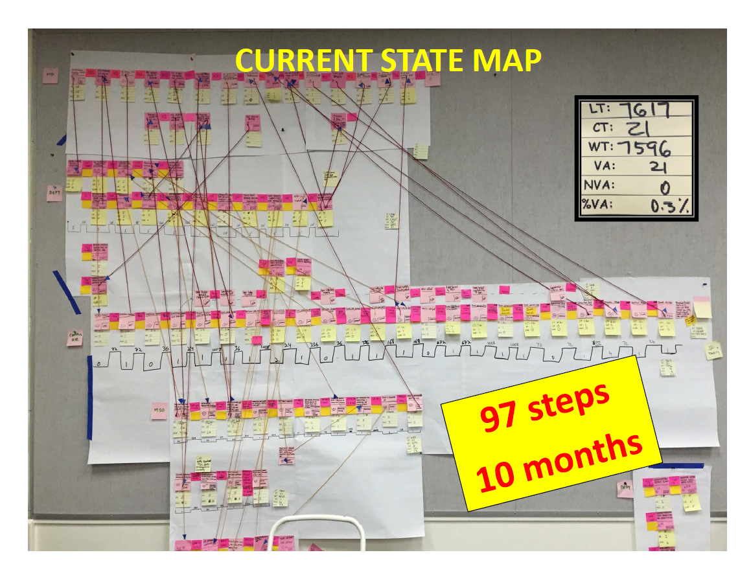
Update - Provider Onboarding Taskforce
Value Stream Map with LEAN | Action Plans
Develop MD Welcome Program for Departments & Day 1 readiness
Create single interface for data to be shared
Simplify the layers of approval
Implement Now’s

Slide 16
Update - Provider Onboarding Taskforce
Since the VSM in June...
Piloting Welcome Program with two departments using the “Secure Box” (similar to Dropbox) rollout on October 1st
Welcome Video to be created for clearer communication efforts
Taskmaster efficiency issue fixed
Governance Oversight Committee created and includes: Josh Adler, David Odato, Cynthia Leathers, Brian Alldredge and some chairs
Discovery to design a single frontend interface underway
Driving Considerations in Design (for single frontend interface)
Simplicity: Coherence and consistent workflow
Facilitates consolidating efforts around effective and efficient work processes (APeX duties, ARF, UCMe, Advance, Taskmaster, Echo, OLPPS)
Promotes feasibility and transparency for both customer (MD) and for everyone involved in onboarding– room for dialogue, discovery and innovative close collaboration.

Slide 17
Medical Staff Investigations
We all know how to onboard a physician, but not clear of all the different ways to “off-board” a physician.
State statutes permit physicians to conduct peer review and allow this process to be protected from discovery (with exception to federal court systems). CA Business and Professions Code 1156-1157.
This type of peer review activity can lead to disciplinary/corrective action for a physician which may include suspensions, reduction/revocation of privileges, limitation of practice, or full termination from the Medical Staff.
All disciplinary/corrective action must be reported to the California Medical Board and the National Practitioner Databank. (This can be career ending for physicians)

Slide 18
Medical Staff Investigations - Process
UCSF Medical Staff Bylaws 3.14
Grounds for action: non-compliance with the bylaws; violation of medical center and medical staff rules/regulations; misconduct, disruptive behavior involving/impacting patient care; clinical competency issues; disruptive behavior that interferes with medical center operations.
Procedures: Any person may provide information to the Department Chair, President of the Medical Staff, or the Chief Medical Officer.
Preliminary Review by division chief/department chair before invoking a request to an ad hoc medical staff peer review investigation.
President of the Medical Staff makes the final decision and appoints an investigatory team supported by Legal Counsel and Medical Staff Affairs
Team will comprise of four to five physician colleagues

Slide 19
Medical Staff Investigations - Process
UCSF Medical Staff Bylaws 3.14
Procedures: Scope of Investigation is determined when President delivers the charge to the investigatory Committee
Witnesses are interviewed with Legal Counsel and Medical Staff involved. This is necessary to protect the testimony and preserve the process.
Bylaws suggest that investigations should be finished within 30 days, but that is NOT the reality. Investigations can last as long as six months because of scheduling woes.
A final report is issued detailing all the evidence, findings, analysis, and recommendations.
Recommendations may include changes/fixes to system issues, and not solely focused on the physician.
The Executive Medical Board deliberates in a closed session, with final discussion with the Chancellor at the Governance Advisory Council.

Slide 20
Medical Staff Investigations – Due Process
UCSF Medical Staff Bylaws 3.15 – Fair Hearing
Physicians have a tremendous amount of due process
Aggrieved physician can provide testimonial evidence/information to defend his/her position.
They can also request that other supporting witnesses provide testimonial, exonerating, or character evidence to defend him/her.
They can appear before the EMB to rebut the final report, which they must be given a copy upon conclusion of the investigation.
They have a right to legal representation.
This is not required, but very smart of physicians to obtain legal counsel.
Physicians can request a fair hearing on the matter, if the recommendations warrant statutory reporting to Medical Board and NPDB.

Slide 21
Medical Staff Investigations – History
“Grey’s Anatomy” Can be Frighteningly True
Inappropriate physical examination of patients
Does an ophthalmologist have any need to conduct a pelvic exam?
Inappropriate romantic/sexual relationship with patients
Physician physically assaulted a member of the care team in the Operating Room
Clinical Competency: physician had a “opps” moment that led to poor outcome
Tried to blame others for the “opps” and the poor outcome
Faculty conducting research outside the IRB process
Mismanagement of University property – i.e. prescription pad

Slide 22
Open Discussion…

