Slide 1
Medical Staff Affairs
Quarterly Update

Slide 2
UCSF HEALTH ADVANCED HEALTH PRACTITIONERS
Nurse Practitioners, Physician Assistants, Certified Nurse Midwives, Certified Nurse Anesthetists
Mitchel Erickson, NP
Director of Advanced Practice for UCSF Health

Slide 3
The term MIDLEVEL PROVIDER is obsolete and was removed from the Institute of Medicine terminology in 2010, using Advanced Practice Registered Nurses as alternative to address the variability in states laws. Medicare uses the term non-physician practitioner. Historically the term was originated by the US Department of Justice’s Drug Enforcement Administration for the sole purpose of monitoring controlled substances. UCSF uses the term AHP or Advanced Health Practitioner.

Slide 4
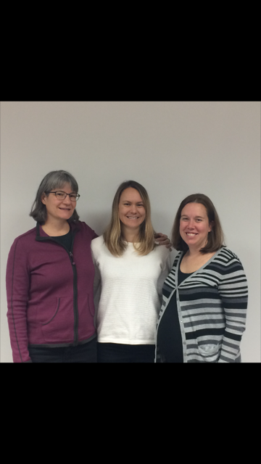
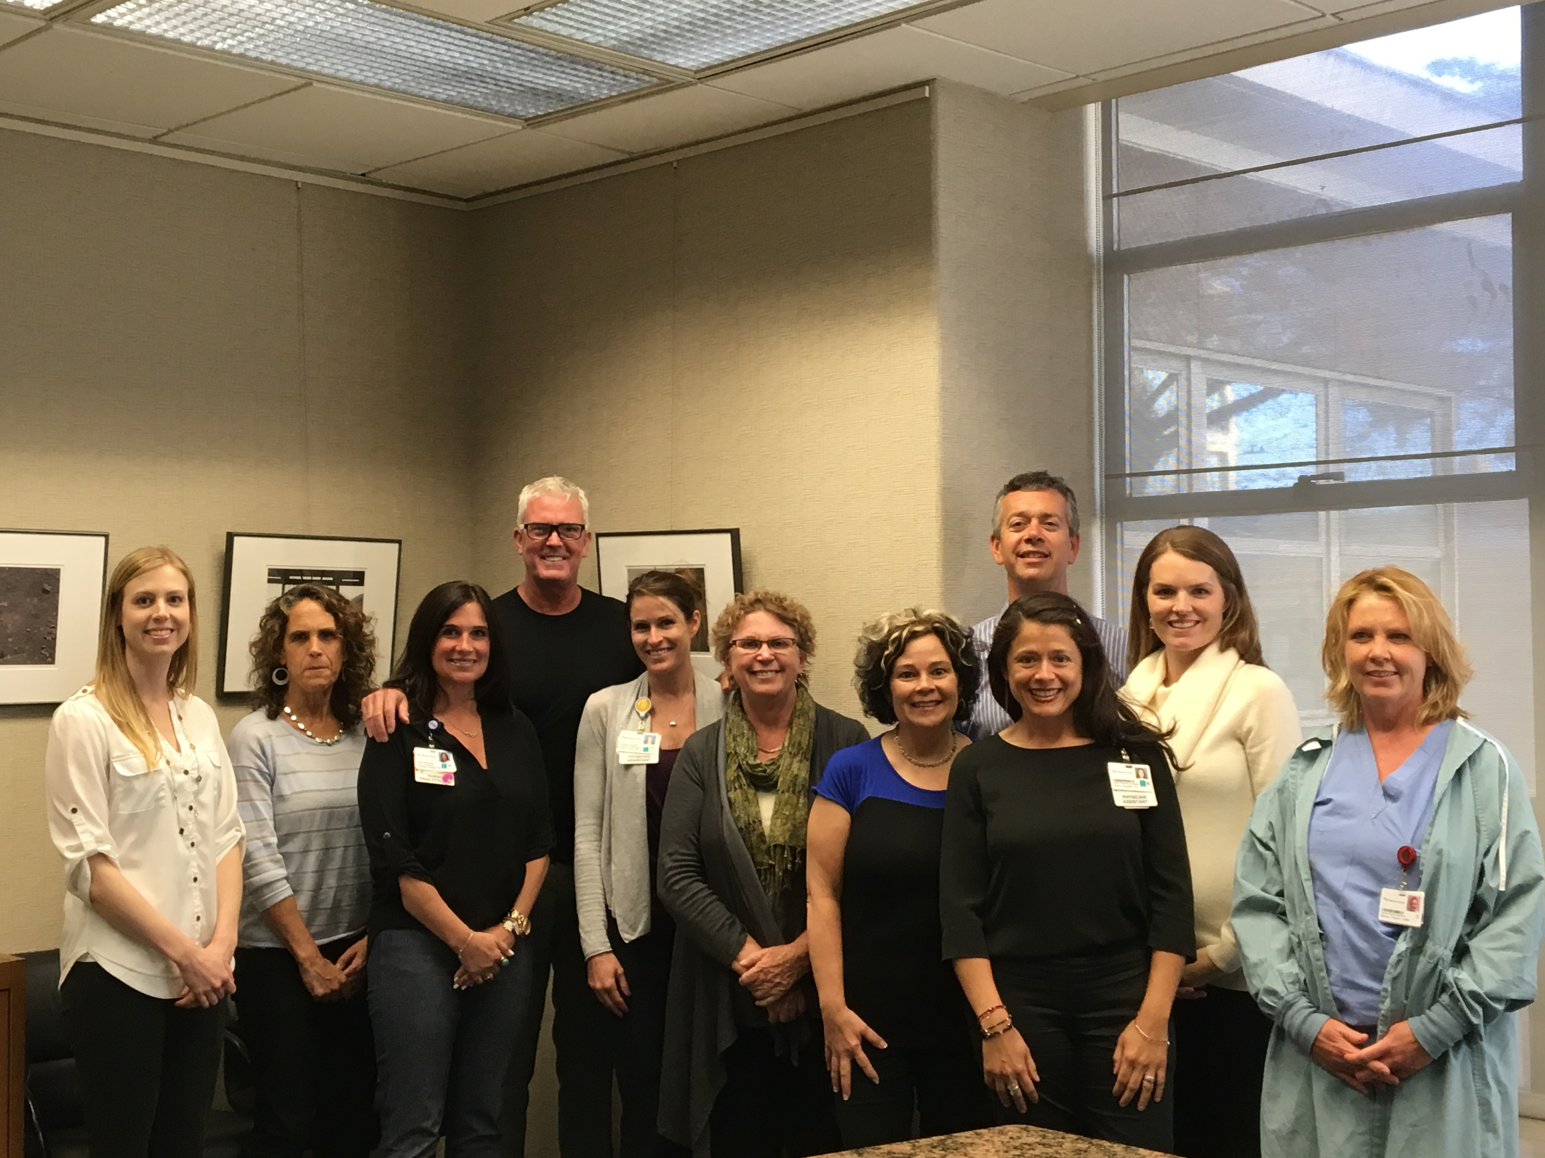
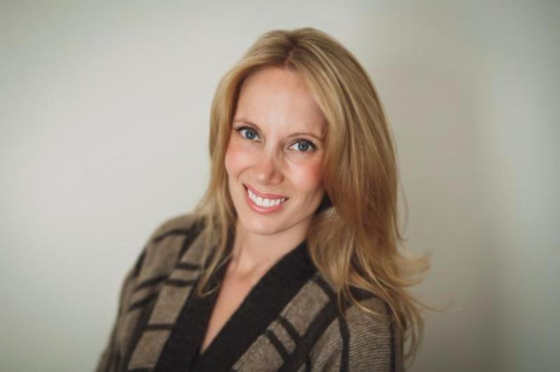
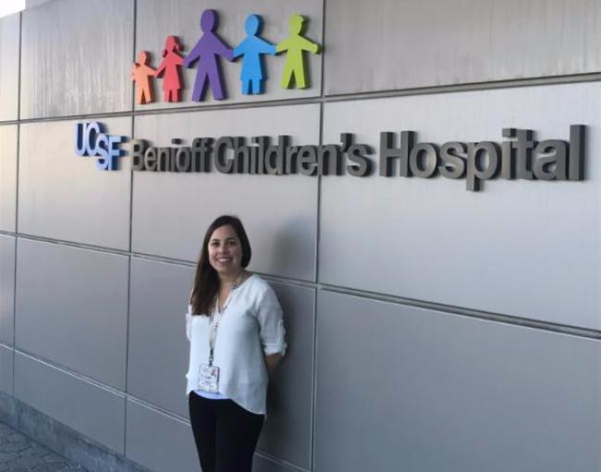
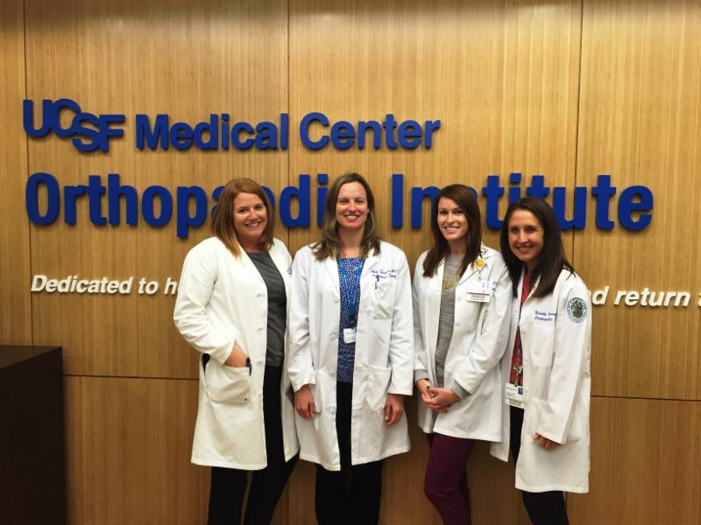
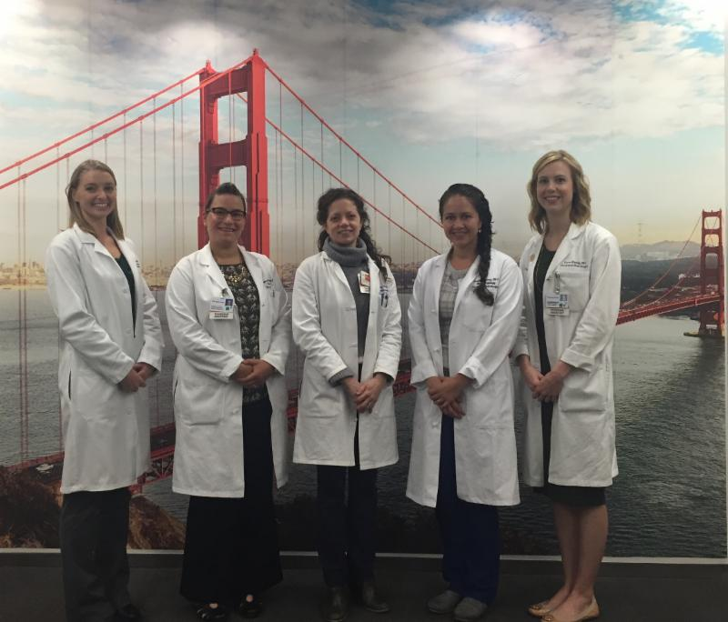
Source: Citation Here

Slide 5
Current state:
48 Nurse Anesthetists
52 Physician Assistants
8 Certified Nurse Midwives
360 Nurse Practitioners (for comparison in 2012 there were about 50)
2018 Physicians
Mitchel Erickson, NP
Director of Advanced Practice

Slide 6
National Comparison:
Per health care system with average licensed bed capacity of 1847 to our 1116 (.41 per licensed bed vs .29 nationally).
- 126 physician assistants
- 299 nurse practitioners
- 94 nurse anesthetists
- 13 nurse midwives
- 1631 physicians (employed MDs includes the medical system not medical group) Vizient data set 2016
Mitchel Erickson, NP
Director of Advanced Practice

Slide 7
Adult Transplant – kidney and liver | Pediatric Transplant – kidney and liver | Advanced Lung Disease | Urology | Breast Cancer Center
Orthopedic Surgery – Adult | Orthopedic Surgery – Pediatrics | Pediatric Palliative Care | Pediatric Bone Marrow Transplant | Interventional Radiology
Neurosurgery | Neurology | Radiation Oncology | Pediatric Gastroenterology | Pediatric Oncology
Neonatal ICU | Pediatric ICU | Adult Medical ICU | Adult Gastroenterology | Labor and Delivery
Cardiovascular Surgery | Dermatology | Cardiology | Pediatric Dialysis | Operating Room
Prepare Perioperative Services | Emergency Medicine Behavioral Health | Outpatient Adolescent and Pediatric Behavioral Health | House Calls Gerontology | Emergency Medicine
Thoracic Surgery | Pediatric/Neonatal Transport | Cardiac Stress Lab | Internal General Medicine | Pediatric HIV
Clinical Decision Unit | Otolaryngology | Head and Neck Surgery | Screening and Acute Care Clinic | Pediatric Immunology
Pulmonary Hypertension | Congestive Heart Failure | Pediatric Hematology | Anticoagulation Clinic | Adult Gastric Surgery
Outpatient Craniofacial Surgery | Pediatric Rheumatology | Infertility Clinic | Pediatric Nephrology | Interventional Radiology
Pediatric Pulmonology | Pediatric Surgery | Pediatric Diabetes Clinic | Adolescent Gender Clinic | Primary Care/Internal Medicine
168 unique specialties
Mitchel Erickson, NP
Director of Advanced Practice

Slide 8
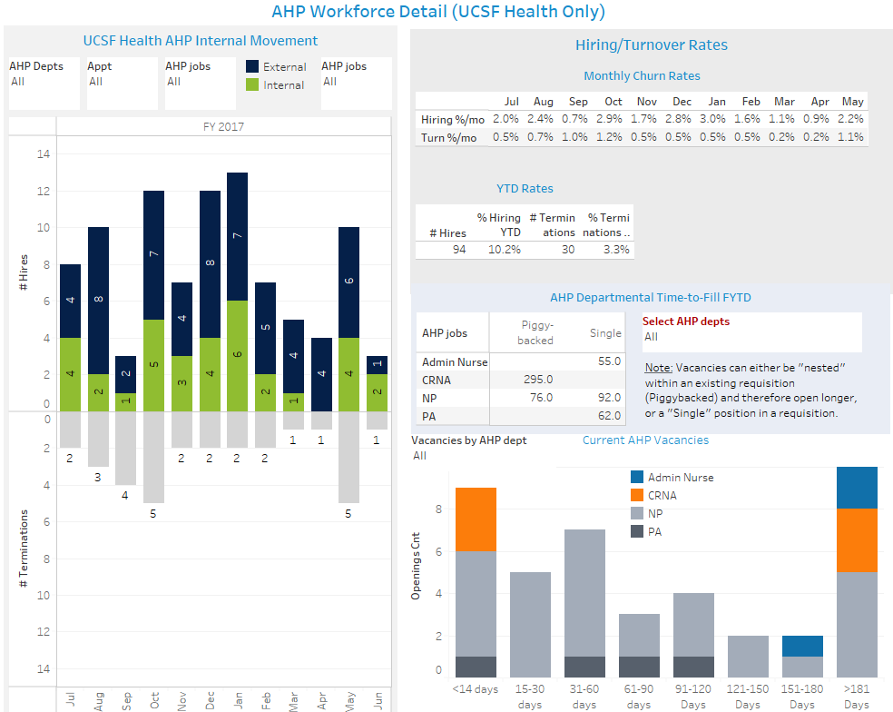
Mitchel Erickson, NP
Director of Advanced Practice

Slide 9
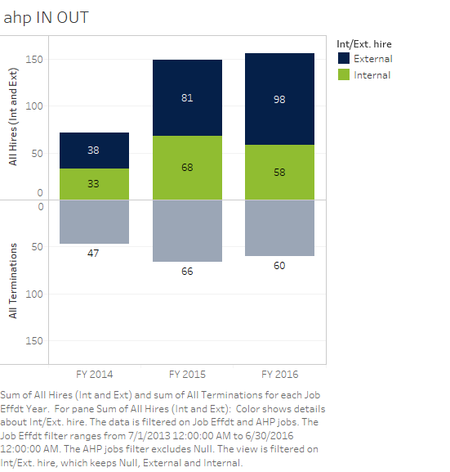
Work Force Metrics from HR
* incomplete secondary to data stream collected from both campus and medical center sources are not synced.
FY16/17 up 116 and loss of 30 non-retirees
Mitchel Erickson, NP
Director of Advanced Practice

Slide 10
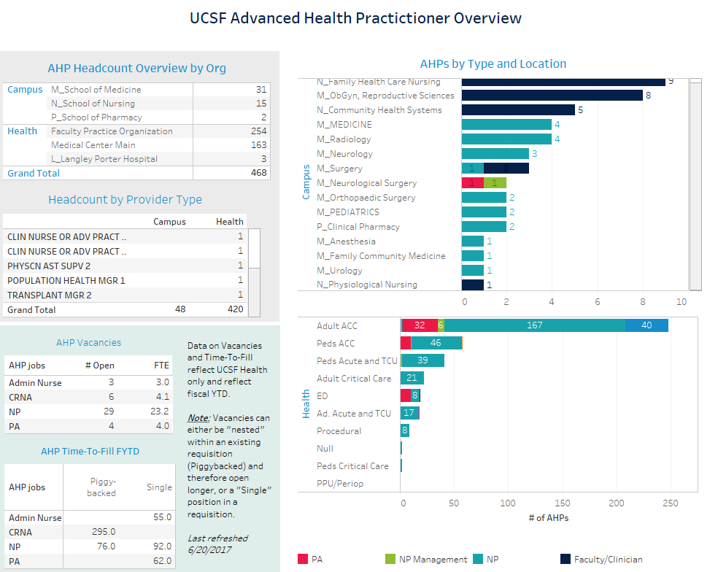

Slide 11
EXPENSE OF TURNOVER
General rule regarding cost to an organization of professional turnover is 1.3X the annual salary.
1.3 X 22 X $140,000 = $4 million dollars loss this fiscal year

Slide 12
Professional visibility
Dedicated AHP web site launched titled Advanced Practice at UCSF Health
Revenue maximization
Ensuring we hire where the need for AHP professional’s services are reduction of non-revenue activities when possible.
Communication and community
AHP Newsletter to communicate succinctly across geography
Productivity and benchmarking
Documentation compliance with payers.
Formalizing the Onboarding to begin on July 26, 2017 and reduce attrition.
Expanding Fellowship opportunities and partnering with UCSF SON for accreditation.
Practice to scope.
Making AHPs part of the patient access solution.
Seeking revenue opportunities
Greater transparency and accuracy of wRVU data.
Using CAP2 and Vizient for data comparison.
Aligning all UC Med Centers in AHP practice.
Recognition awards.
Standardizing JDs, evaluations, and professional ladder.
Open forum events and strategic planning
Mitchel Erickson, NP
Director of Advanced Practice

Slide 13
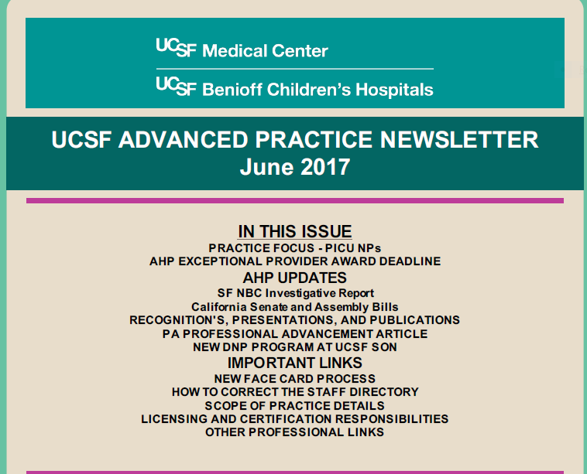
Internal Communications
Diaspora of Advanced Health Providers across UCSF Health complicates communication. A clinical service may have only one AHP practitioner and how we work to make them feel connected and supported by the larger organization and group if imperative. An electronic newsletter was the easiest way to accomplish this and provide information about colleague accomplishments and highlighting practices and vital, need to know information in a 21st Century format.

Slide 14
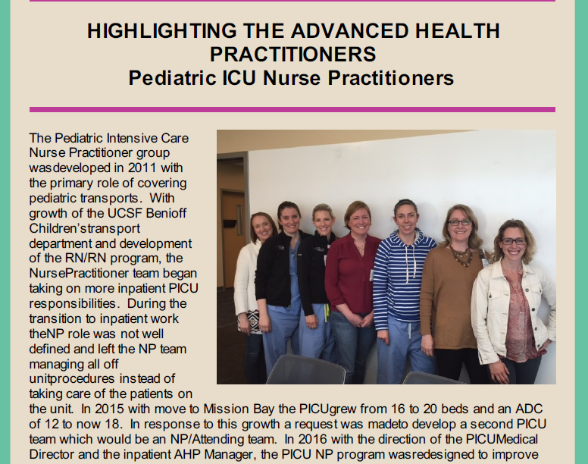

Showcase AHP practice in newsletter and create a online presence.

Slide 15
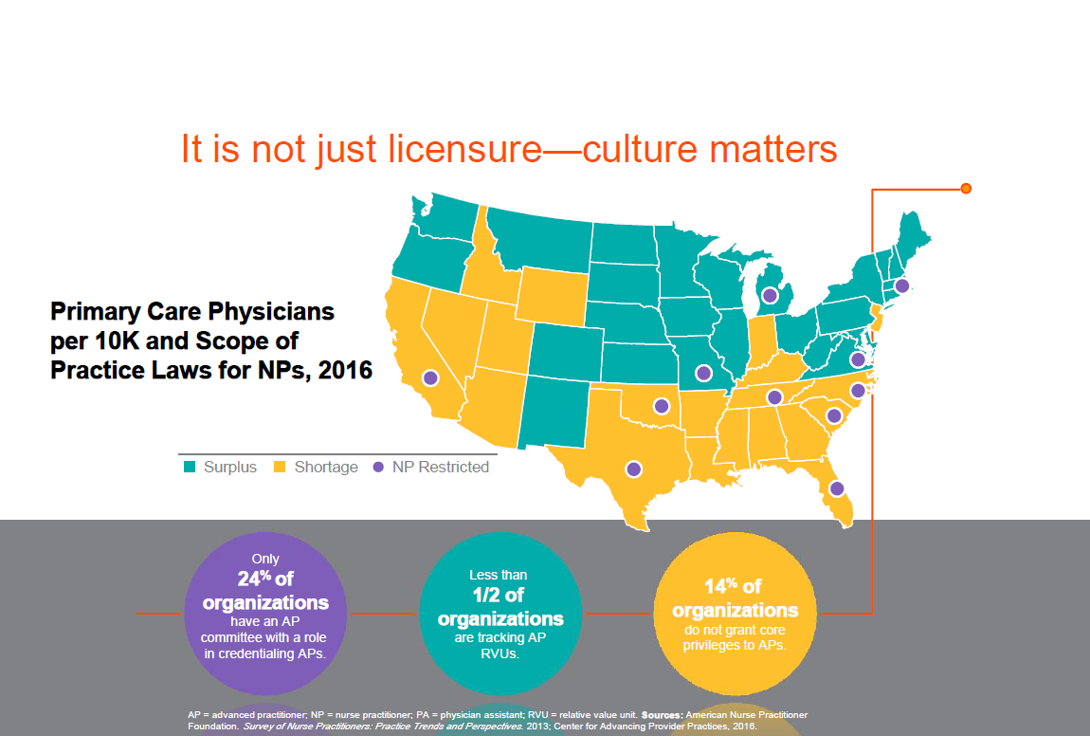
The Future of AHP Practice?
22% of PAs are >50 years old
50% of NPs are >50 years old
By 2025 >33% of Primary Care visits will be completed by AHPs.
<50% of health systems track AHP productivity.
Mitchel Erickson, NP
Director of Advanced Practice

Slide 16
Open Discussion & Questions

Slide 18
Medical Staff Office Updates
James Frieberg, MBA, CPCS
Associate Director, Credentialing & Privileging

Slide 19
2017 Credentialing Processing
3041 Active
Provider
Records
Number of files that we’re actively managing continues to increase
Credentialing
for 10 different
partnership
agreements
Overall file processing time is going down.
Notes:
How many provider records?
Busier than ever
Processing faster than ever
Monitoring increasing number of data metrics to constantly improve our processes/workflows
CVO team is adjusting their model and workflow but as of September they’ve been processing files faster than ever before
These have been incredible improvements for our Credentialing and Privileging teams and they’re only continuing to get better and better .

Slide 20



Data Integrity Checks
Monthly ‘Look-back’ Inquiry to examine data for new and reappointments
Implemented additional means to ensure that we have the right data
into our system for your providers upfront. This effective eliminates the potential for confusion or downstream errors moving forward

Slide 21

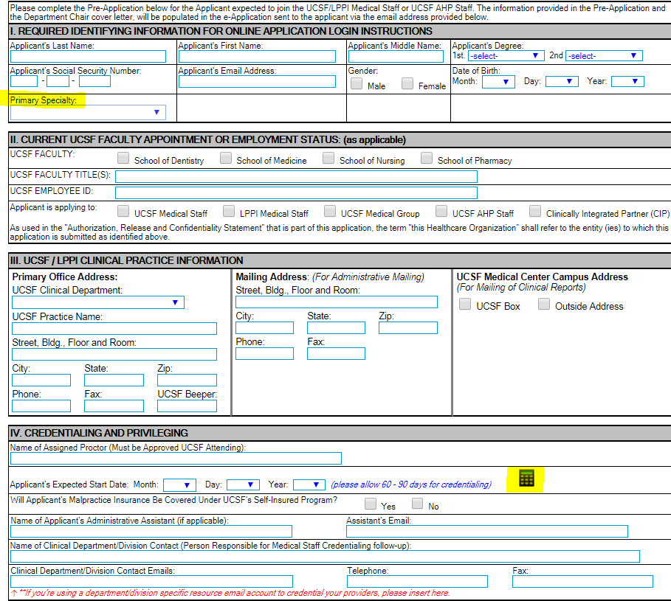
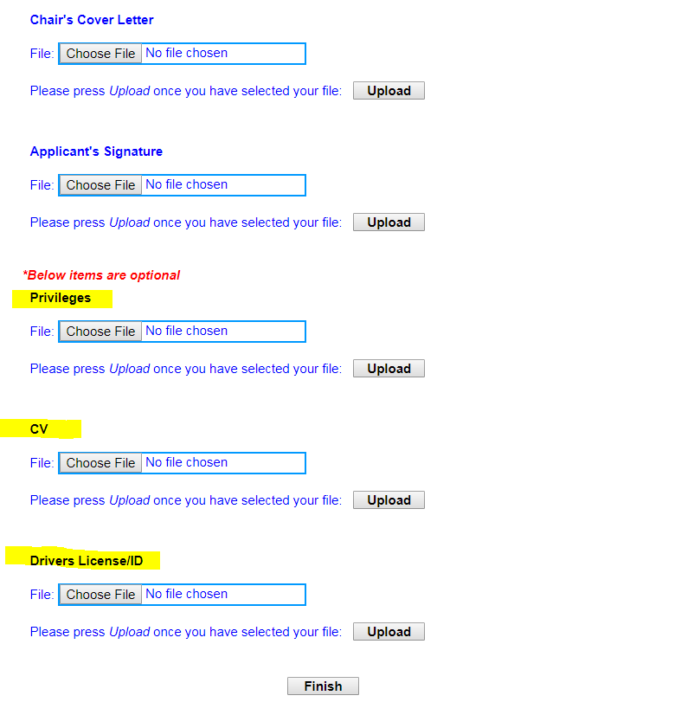
Notes:
Based on what? Why did we do this….
In an effort to help streamline things, we’ve added in this ability to upload additional documents including privileges that the provider should be applying for
And also the ability for you to tell us what the provider’s primary specialty is

Slide 22
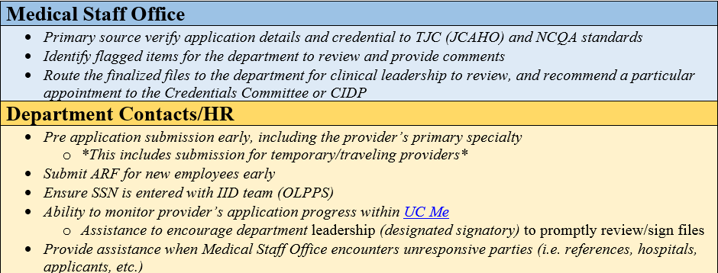
Responsibilities and Tips/Tricks

Slide 23
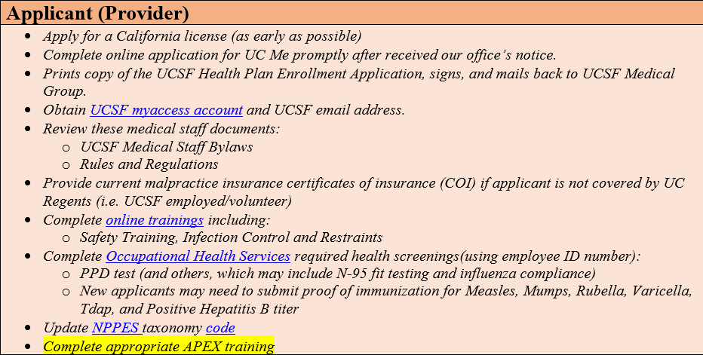
Responsibilities and Tips/Tricks

Slide 24
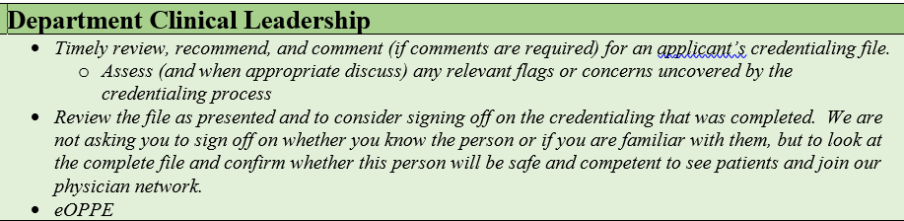
Responsibilities and Tips/Tricks

Slide 25
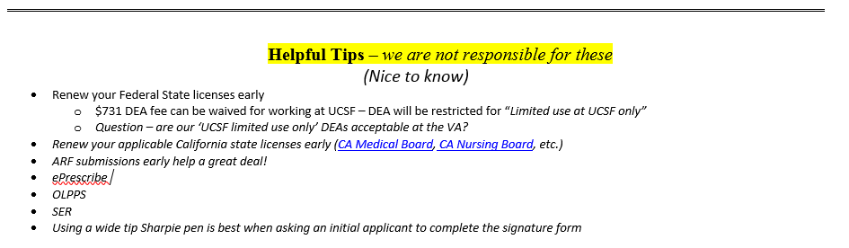
Responsibilities and Tips/Tricks

Slide 26
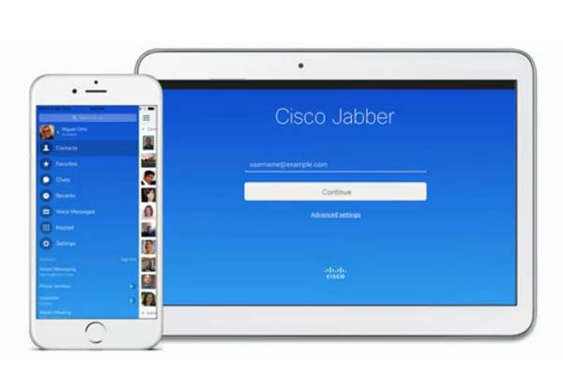
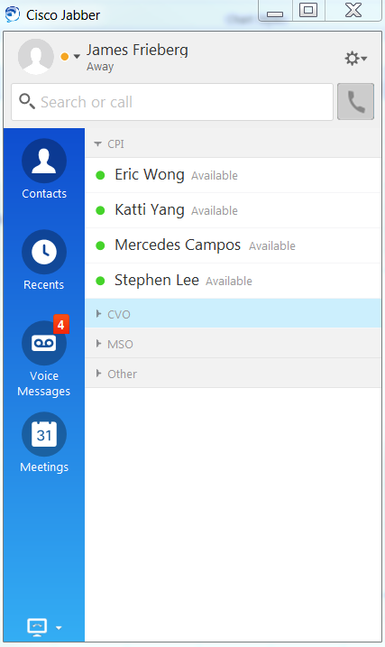
Preview of what’s ahead…
Use of Cisco Jabber
https://software.ucsf.edu/software
Notes:
Many in our office have been increasing been using Cisco Jabber as a means to quickly communicate amongst teams instead of calling/emailing
If you don’t already have/use this tool – I

Slide 27
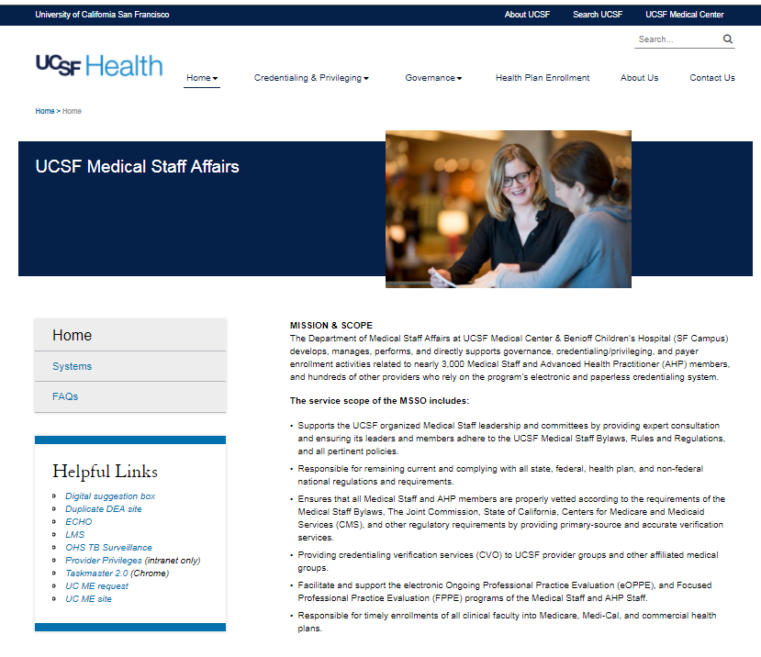
New Medical Staff Office Website

Slide 28
Open Discussion

